Slide 1
Scaling up the effect of cross-ecosystem subsidy to the landscape: a multi-layered approach
Altermatt lab -
EMERGe Working group
Eric Harvey*, Isabelle Gounand*, Emanuel Fronhofer and Florian Altermatt
(“blue-green experiment“)

Slide 2
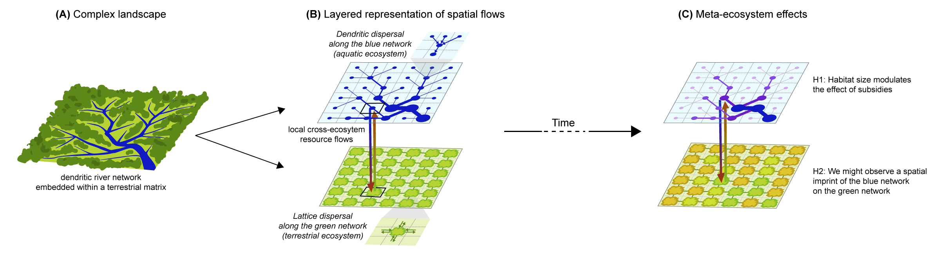
The conceptual framework (figure 1)
Panel c could be removed since the results don’t match with the hypotheses
Panel b should explicitly show an isolated versus connected scenario
Could become a vertical figure

Slide 3
Methods
Treatments: with or without cross-ecosystem flows
4 replicate landscapes (504 microcoms)
7sp in blue / bacteria in green
dispersal/subsidy/perturbation days:
5 sampling dates: 0, 7, 15, 21, 29

Slide 4
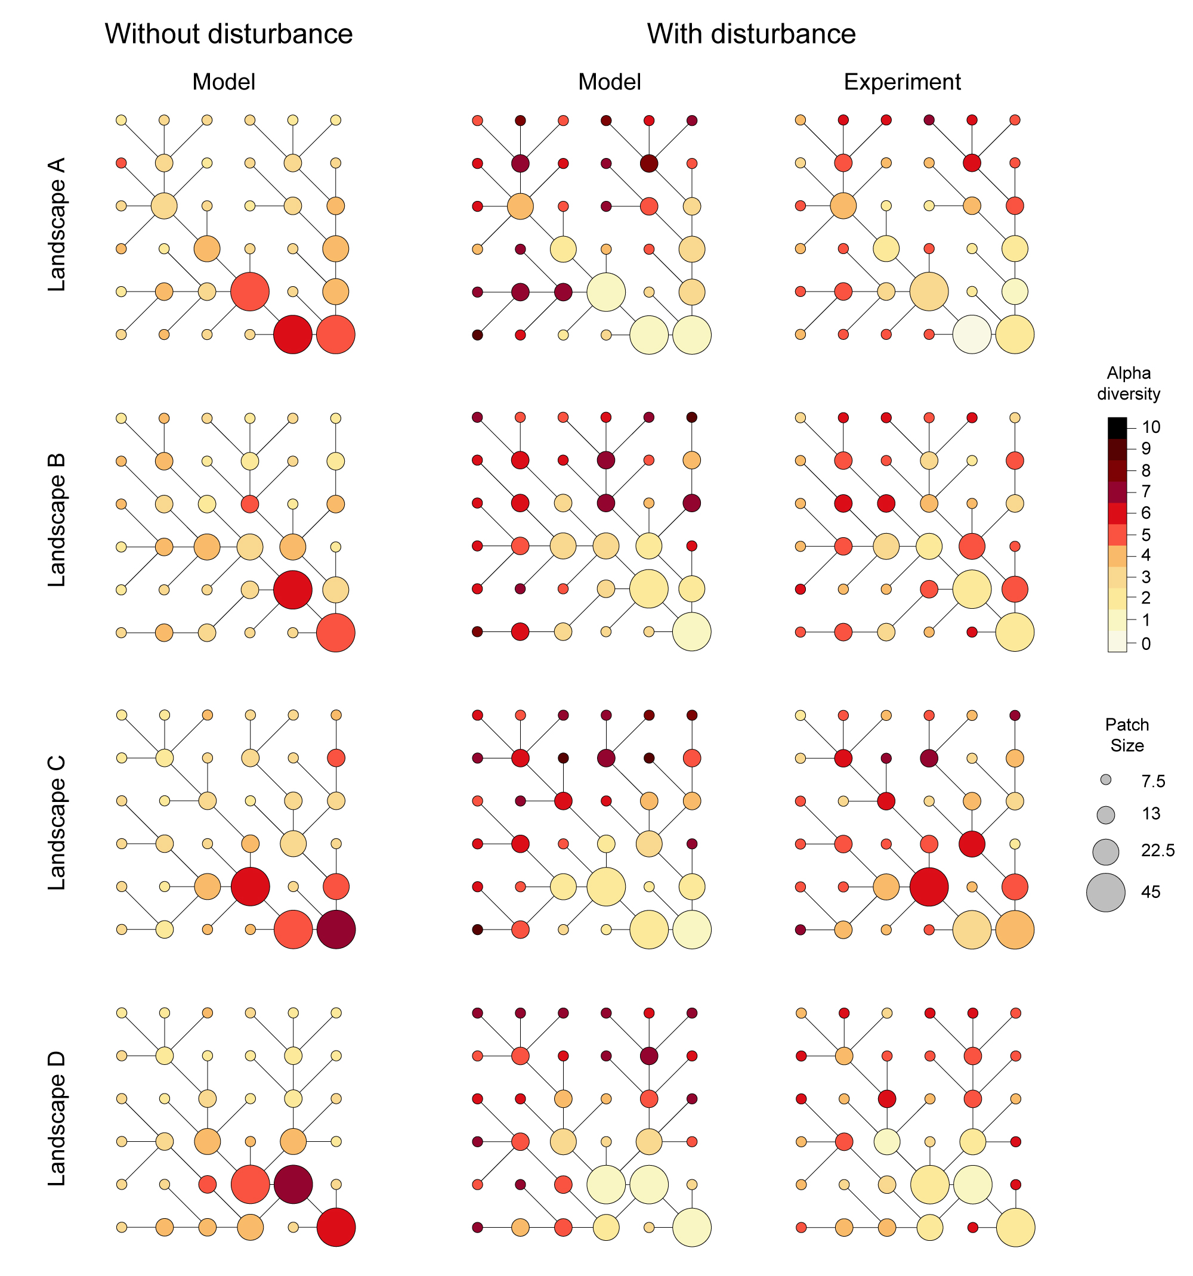
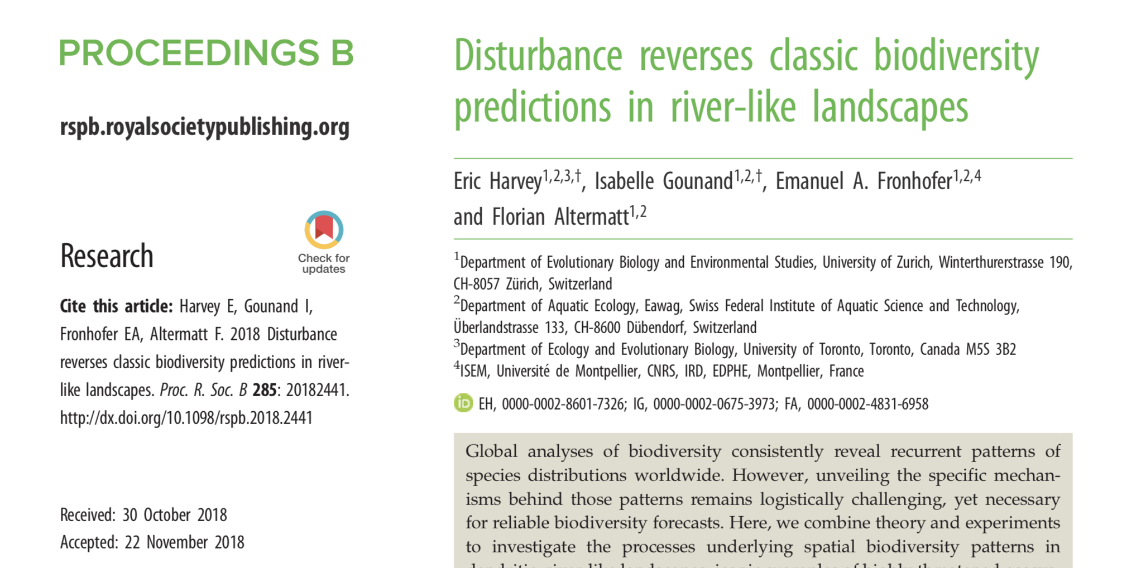
Blue-Green 1
In isolated blue networks:
Perturbations reverse the
classical alpha diversity pattern
in dendritic networks

Slide 5
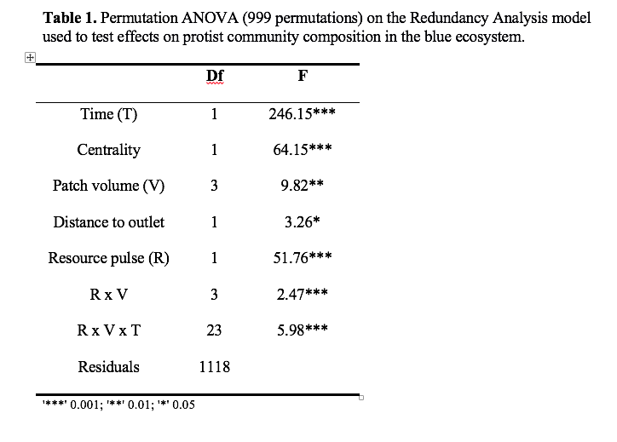
Blue-Green 2 : Effects of cross-ecosystem flows
A) on community composition in blue networks => RDA + Permutation ANOVA
Redundancy analysis
Explains 31% of the variance
Ordination space: 87% represented in axes 1 and 2

Slide 6
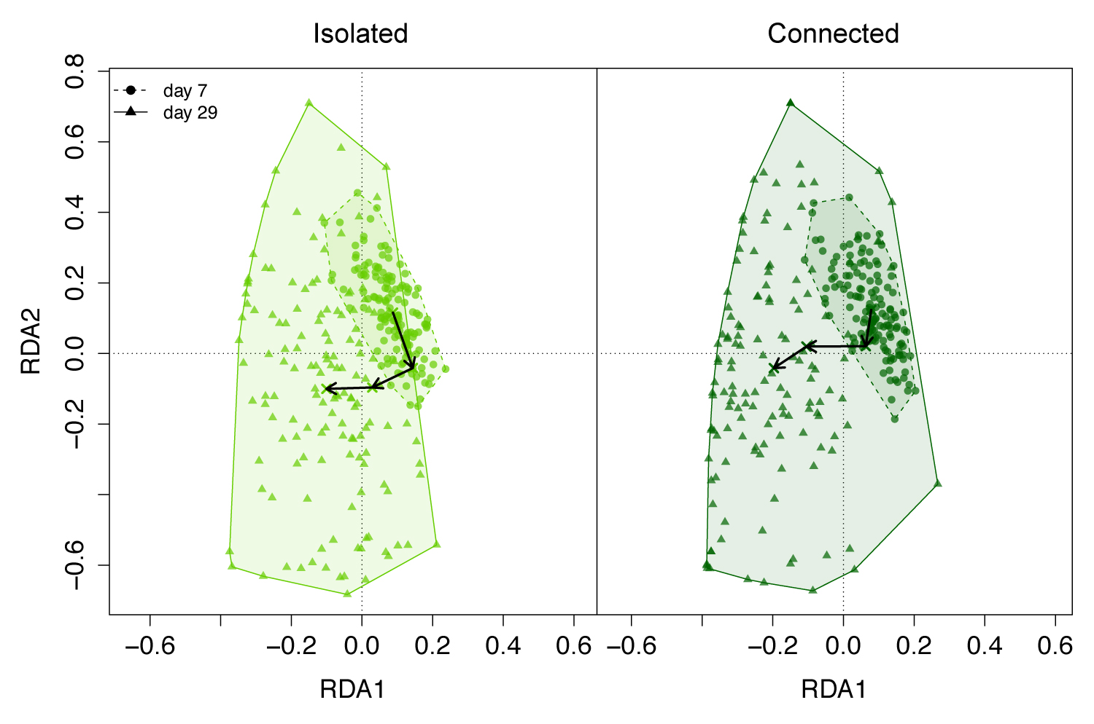
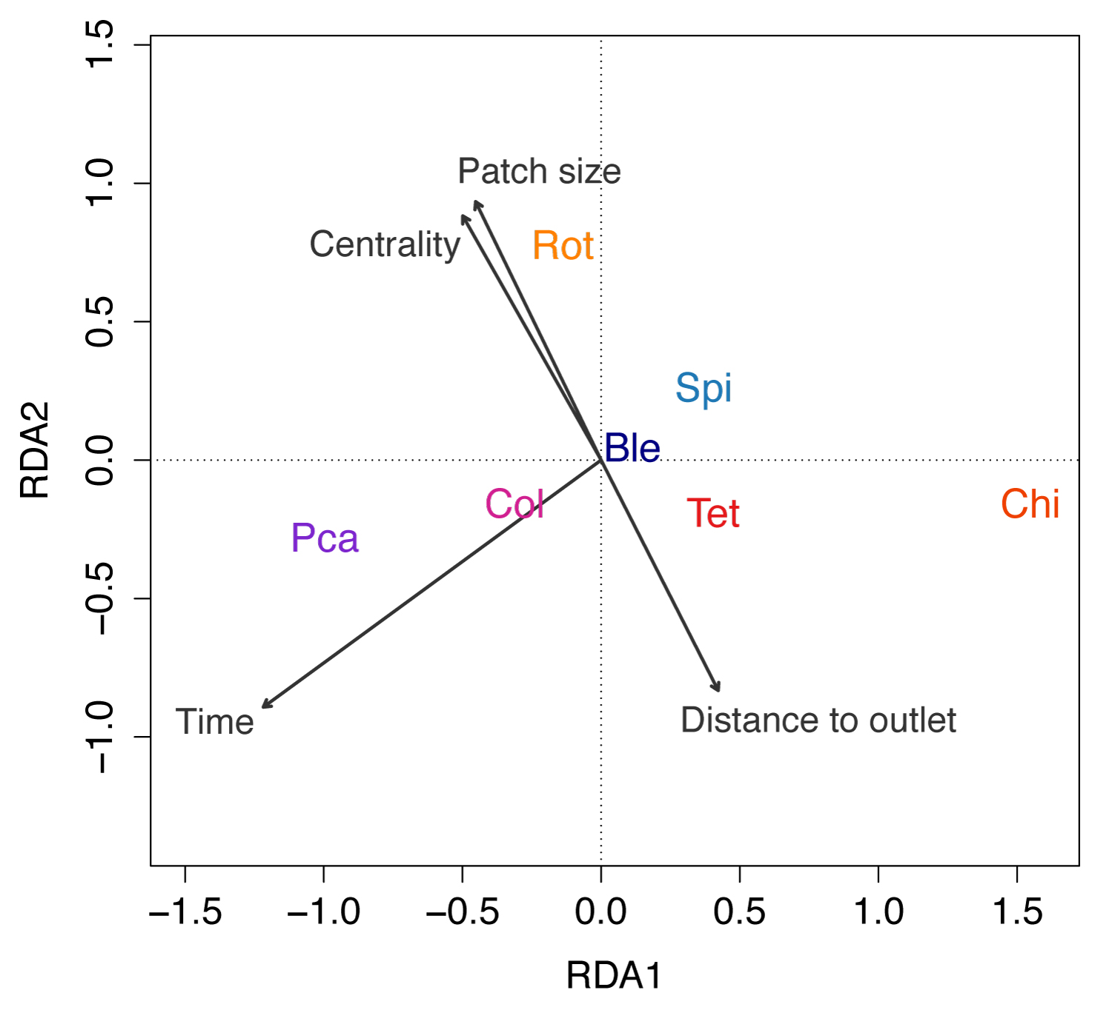
Blue-Green 2 : Effects of cross-ecosystem flows
A) on community composition in blue networks => RDA + Permutation ANOVA
I have tried to make the effects more visually obvious by display group of points into different panels (see in slides 6 to 8)
but this not a lot more convincing; finally I think we should not show the ordination plot (only the table)
Chelsea suggested to show the changes in mean composition with barplots (slides 9 to 10)
Note also that she was quite interested by the project and proposed to readof the ms if we want

Slide 7
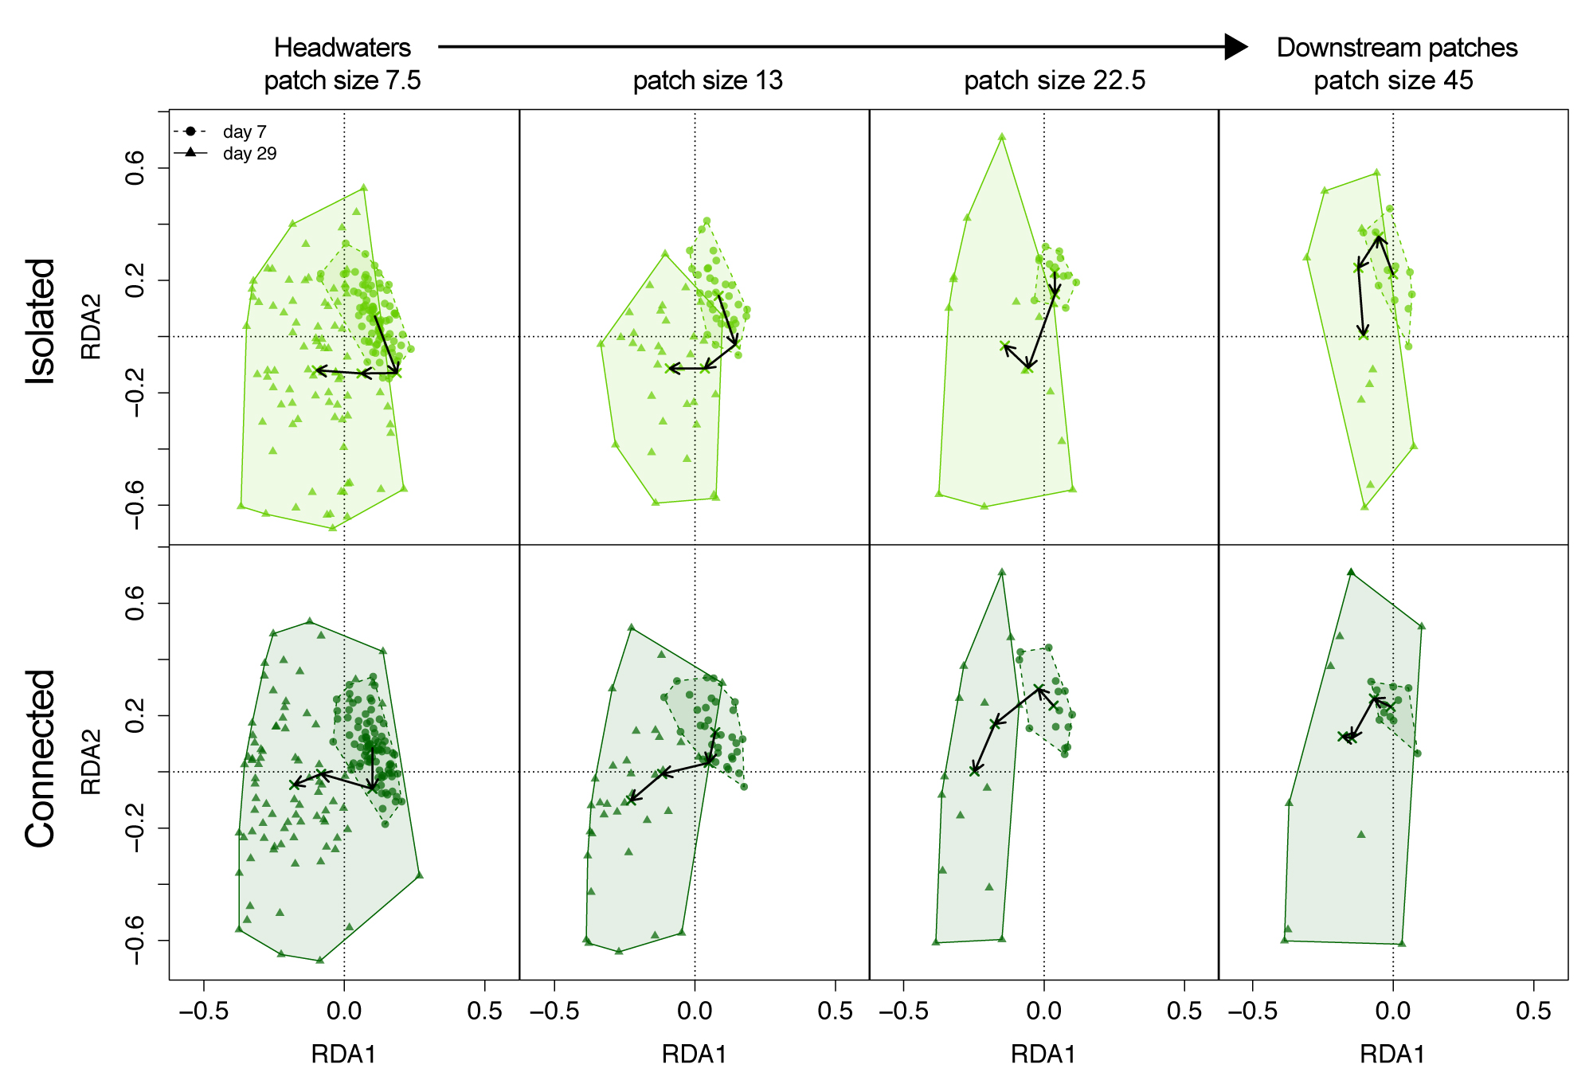
Blue-Green 2 : Effects of cross-ecosystem flows
A) on community composition in blue networks => RDA + Permutation ANOVA

Slide 8
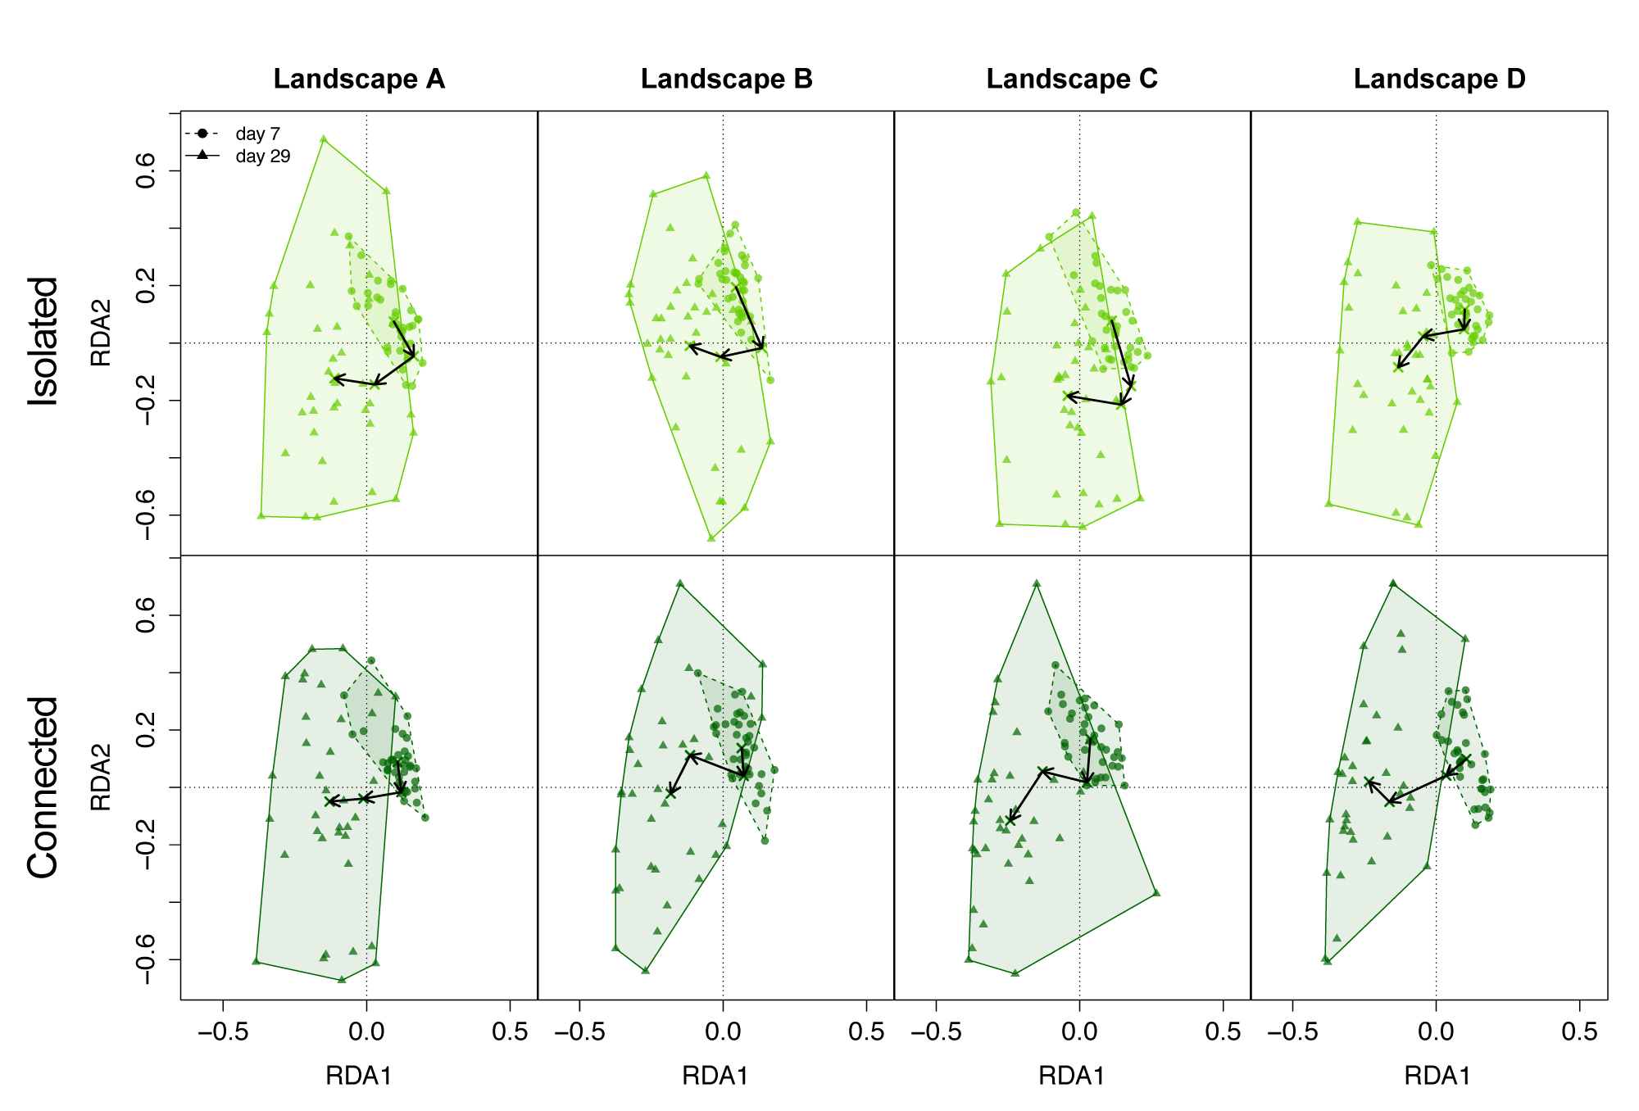
Blue-Green 2 : Effects of cross-ecosystem flows
A) on community composition in blue networks => RDA + Permutation ANOVA

Slide 9
Blue-Green 2 : Effects of cross-ecosystem flows
A) on community composition in blue networks => RDA + Permutation ANOVA
So, on the suggestion of Chelsea, here are other trials to show the same data with barplots (average relative densities)
Isolated (I)
Connected (C)
t0
stock
Patch sizes (t7 to t29 pooled)
Tet
7.5
13
22.5
45
Chi
Col
Pca
Ble
Spi
Rot
I
C
I
C
I
C
I
C
days

Slide 10
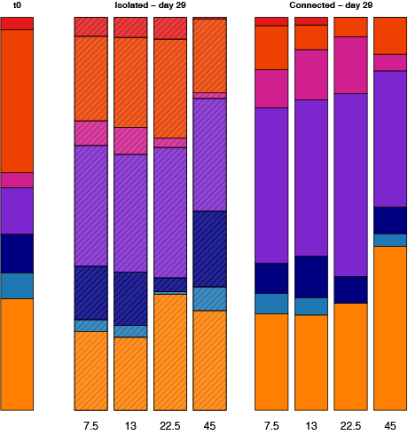
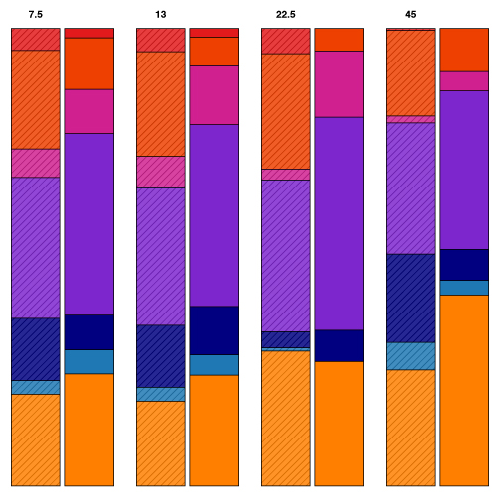
Blue-Green 2 : Effects of cross-ecosystem flows
A) on community composition in blue networks => RDA + Permutation ANOVA
Day 29
t0
Day 29
Isolated (I)
Connected (C)
Tet
7.5
13
22.5
45
Chi
Col
Pca
Ble
Spi
Rot
patch size
I
C
I
C
I
C
I
C

Slide 11
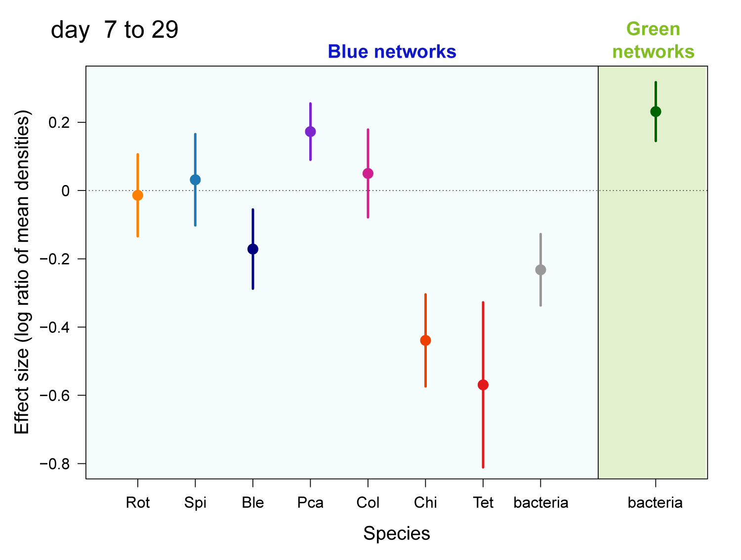
Blue-Green 2 : Effects of cross-ecosystem flows
B) Effect size on species (log ratio of density isolated versus connected)
Note that in slides 11 to 14
I have added the bacteria
in the blue network
If you don’t like it, see
slides 15 to 18 without

Slide 12
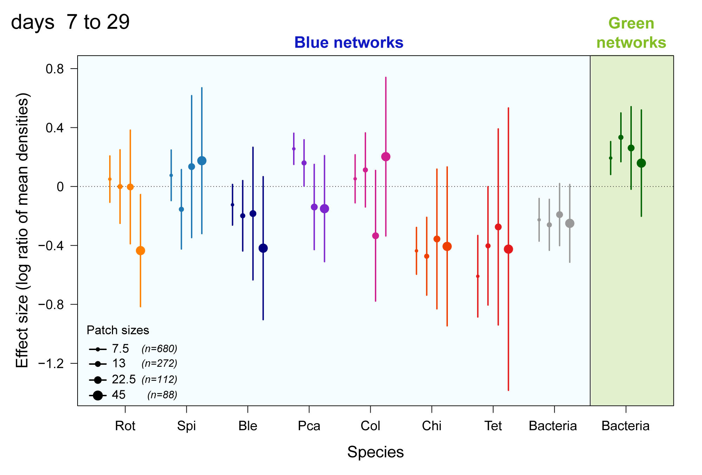
Blue-Green 2 : Effects of cross-ecosystem flows
B) Effect size on species (log ratio of density isolated versus connected)
It is clearer if we group
by species and not by size

Slide 13
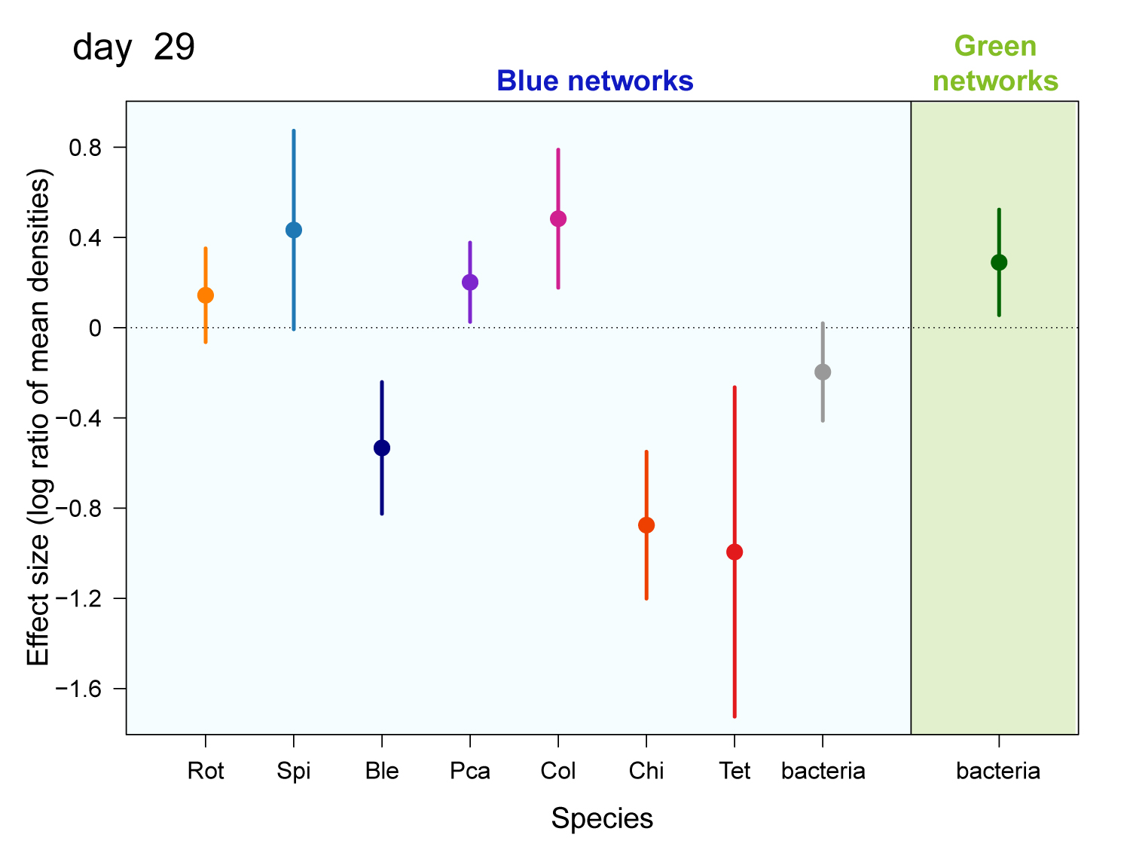
Blue-Green 2 : Effects of cross-ecosystem flows
B) Effect size on species (log ratio of density isolated versus connected)
In slides 13, 14, 17, 18, I show the
LRR only for day 29 because it could
be relevant to look at the divergence
of communities at the end only

Slide 14
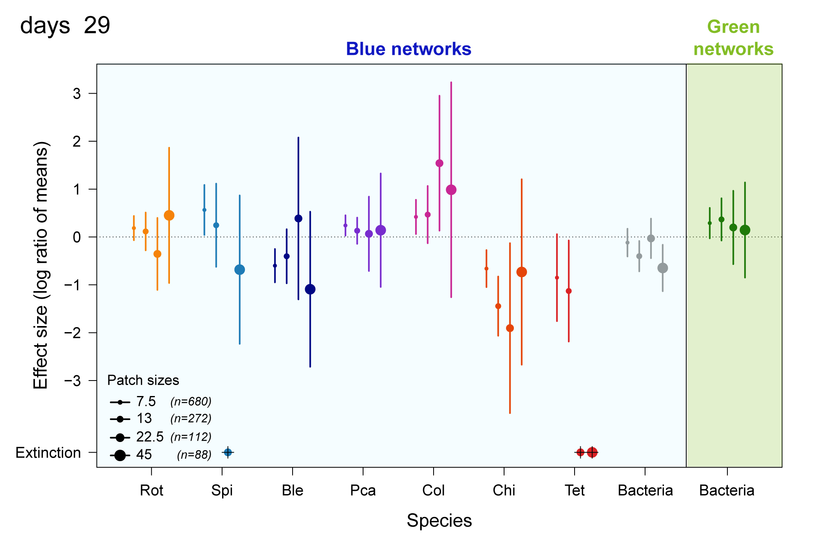
Blue-Green 2 : Effects of cross-ecosystem flows
B) Effect size on species (log ratio of density isolated versus connected)

Slide 15
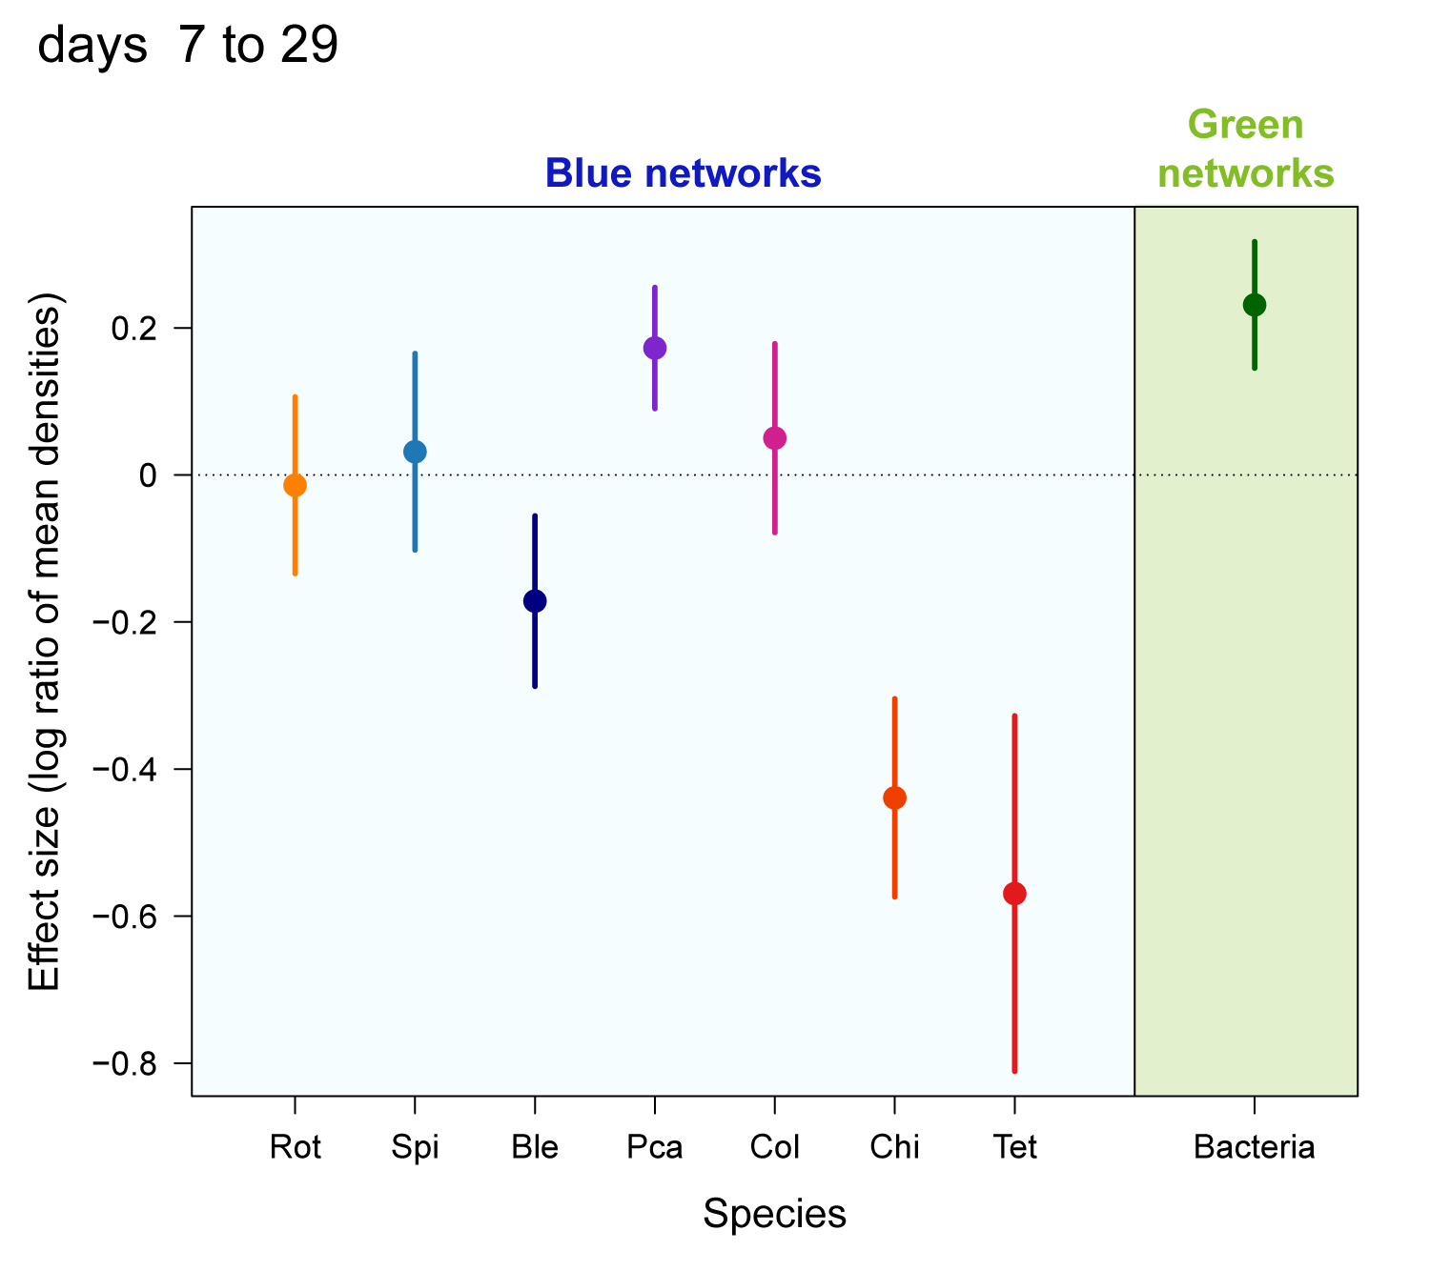
Blue-Green 2 : Effects of cross-ecosystem flows
B) Effect size on species (log ratio of density isolated versus connected)
The 4 next slides are the same
without bacteria in the blue landscapes

Slide 16
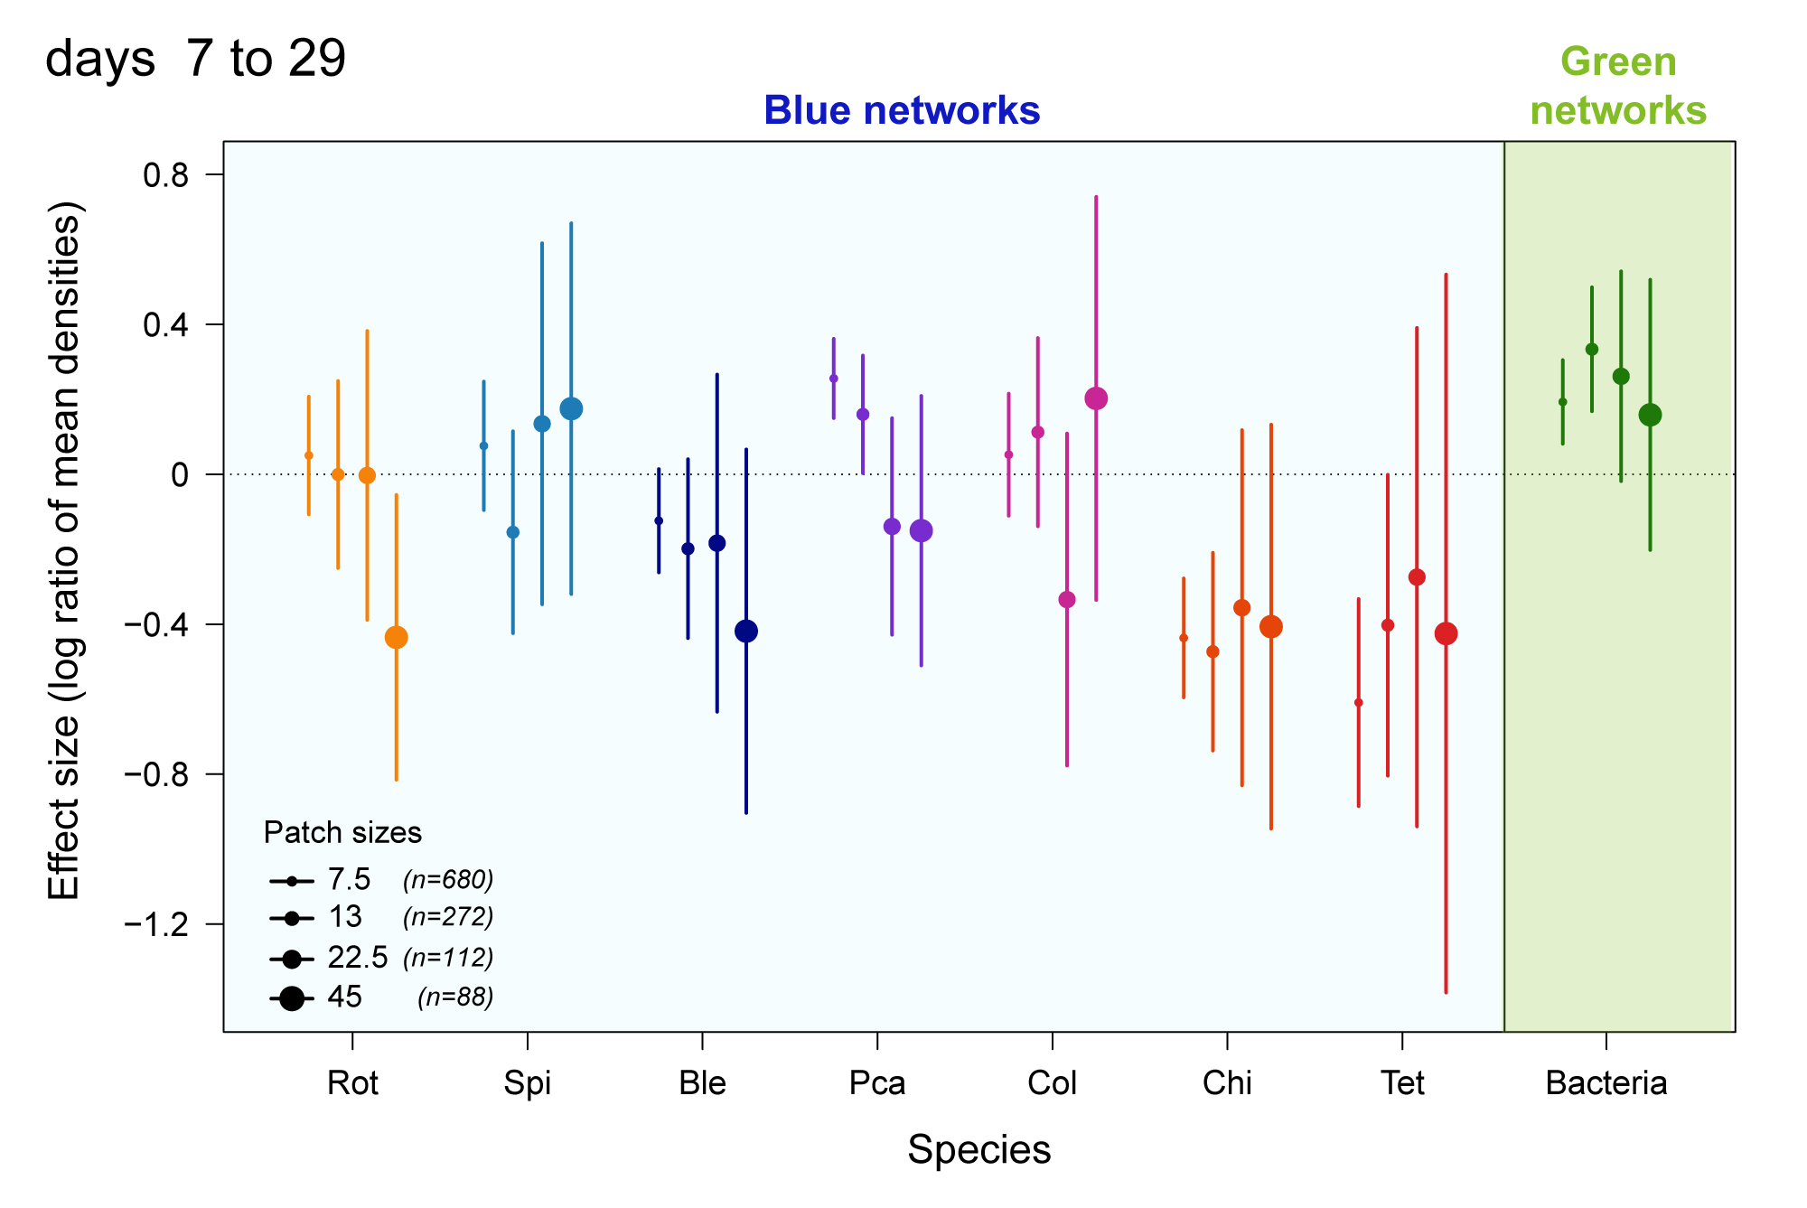
Blue-Green 2 : Effects of cross-ecosystem flows
B) Effect size on species (log ratio of density isolated versus connected)

Slide 17
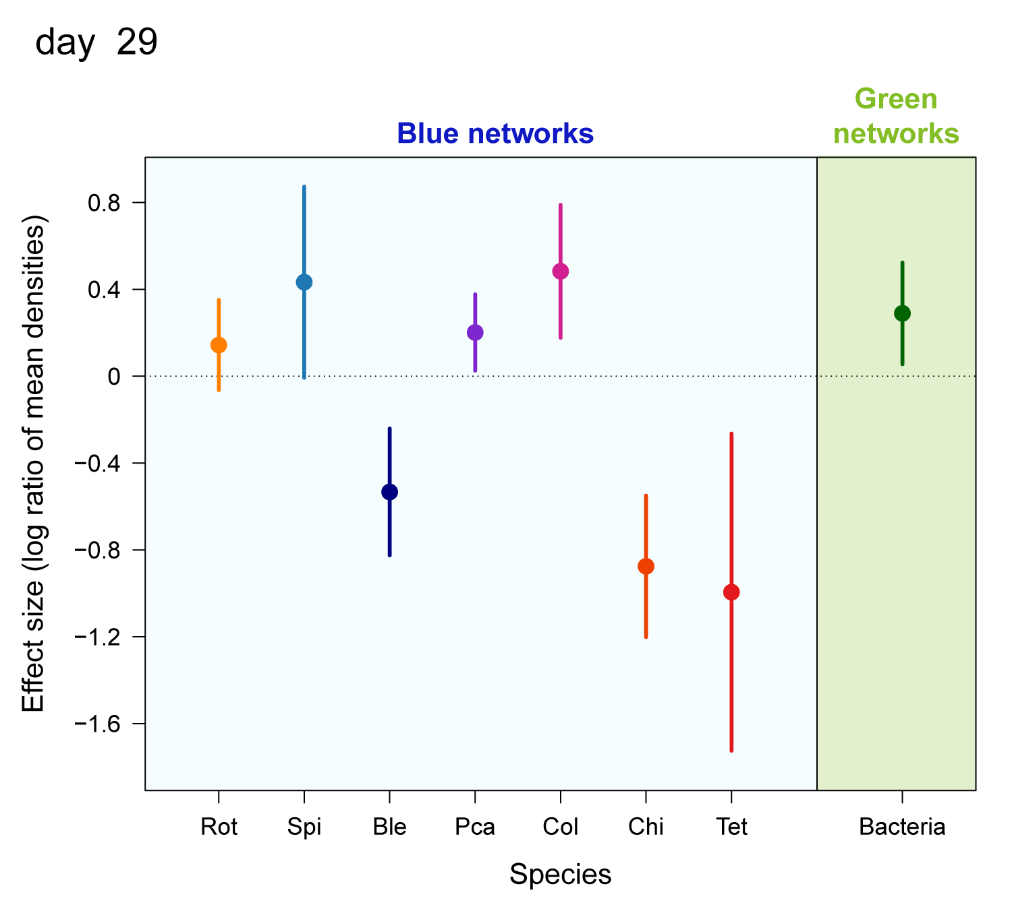
Blue-Green 2 : Effects of cross-ecosystem flows
B) Effect size on species (log ratio of density isolated versus connected)

Slide 18
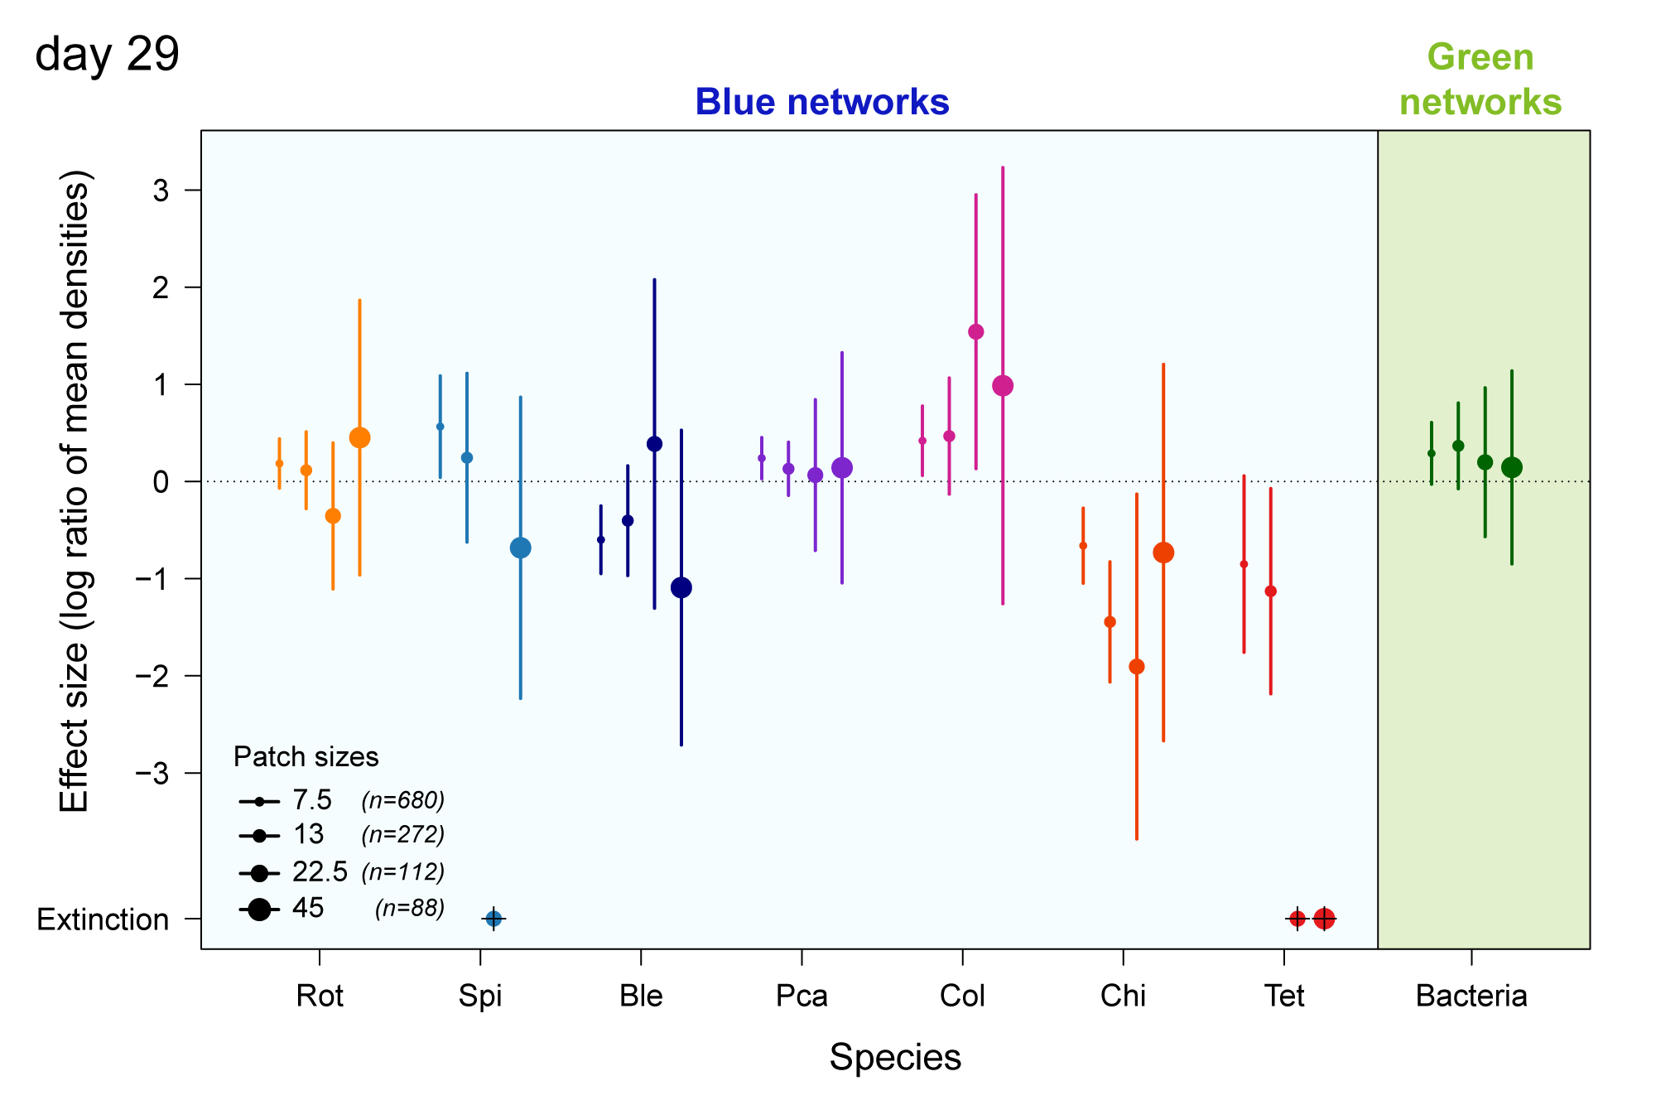
Blue-Green 2 : Effects of cross-ecosystem flows
B) Effect size on species (log ratio of density isolated versus connected)

Slide 19
I also tried Landscape plots of the LRR (see files attached)
both for aggregate metrics (file « LRR_spatial.pdf », but note that scales were not opitmised)
and for species, for averages over t7 to t 29 (file « LRR_spatial_species_days7to29.pdf »)
and for the last time point (file « LRR_spatial_species_days29.pdf »)
but having a glance at it the patterns are quite variables with the landscape…
I leave you have a look at it and tell me if you get an idea of what we can show

Slide 20
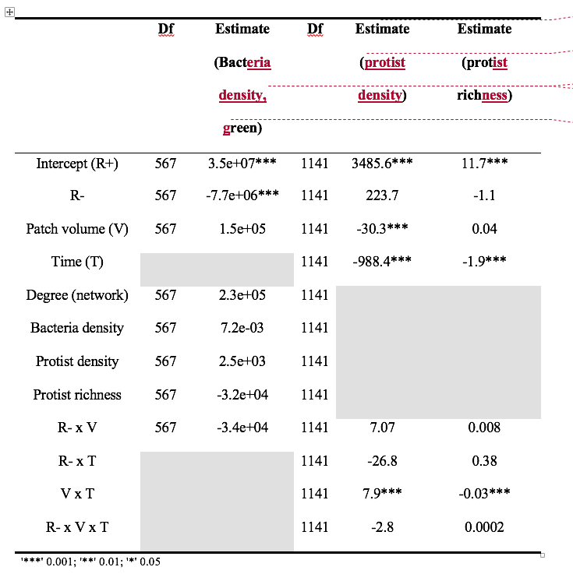
Mixed effect model
on aggregate metrics

